Slide 1
.Net container advancements in .Net 8

Slide 2
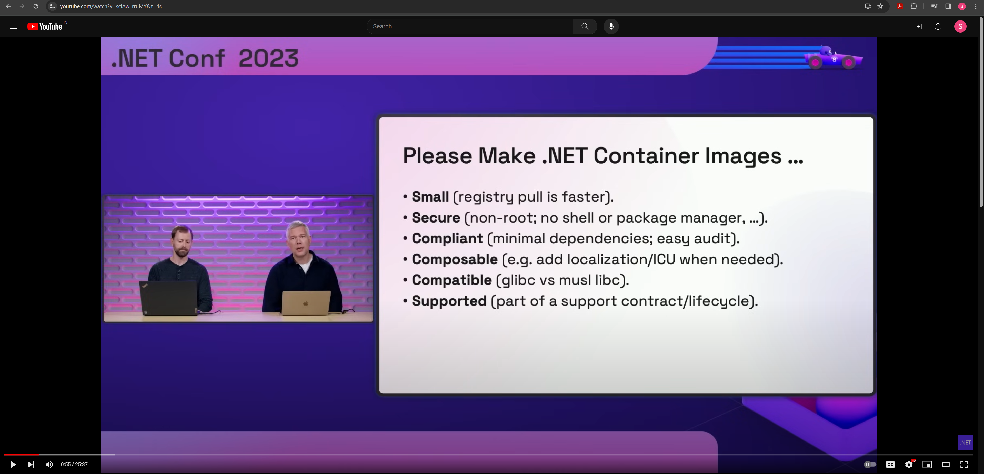

Slide 3
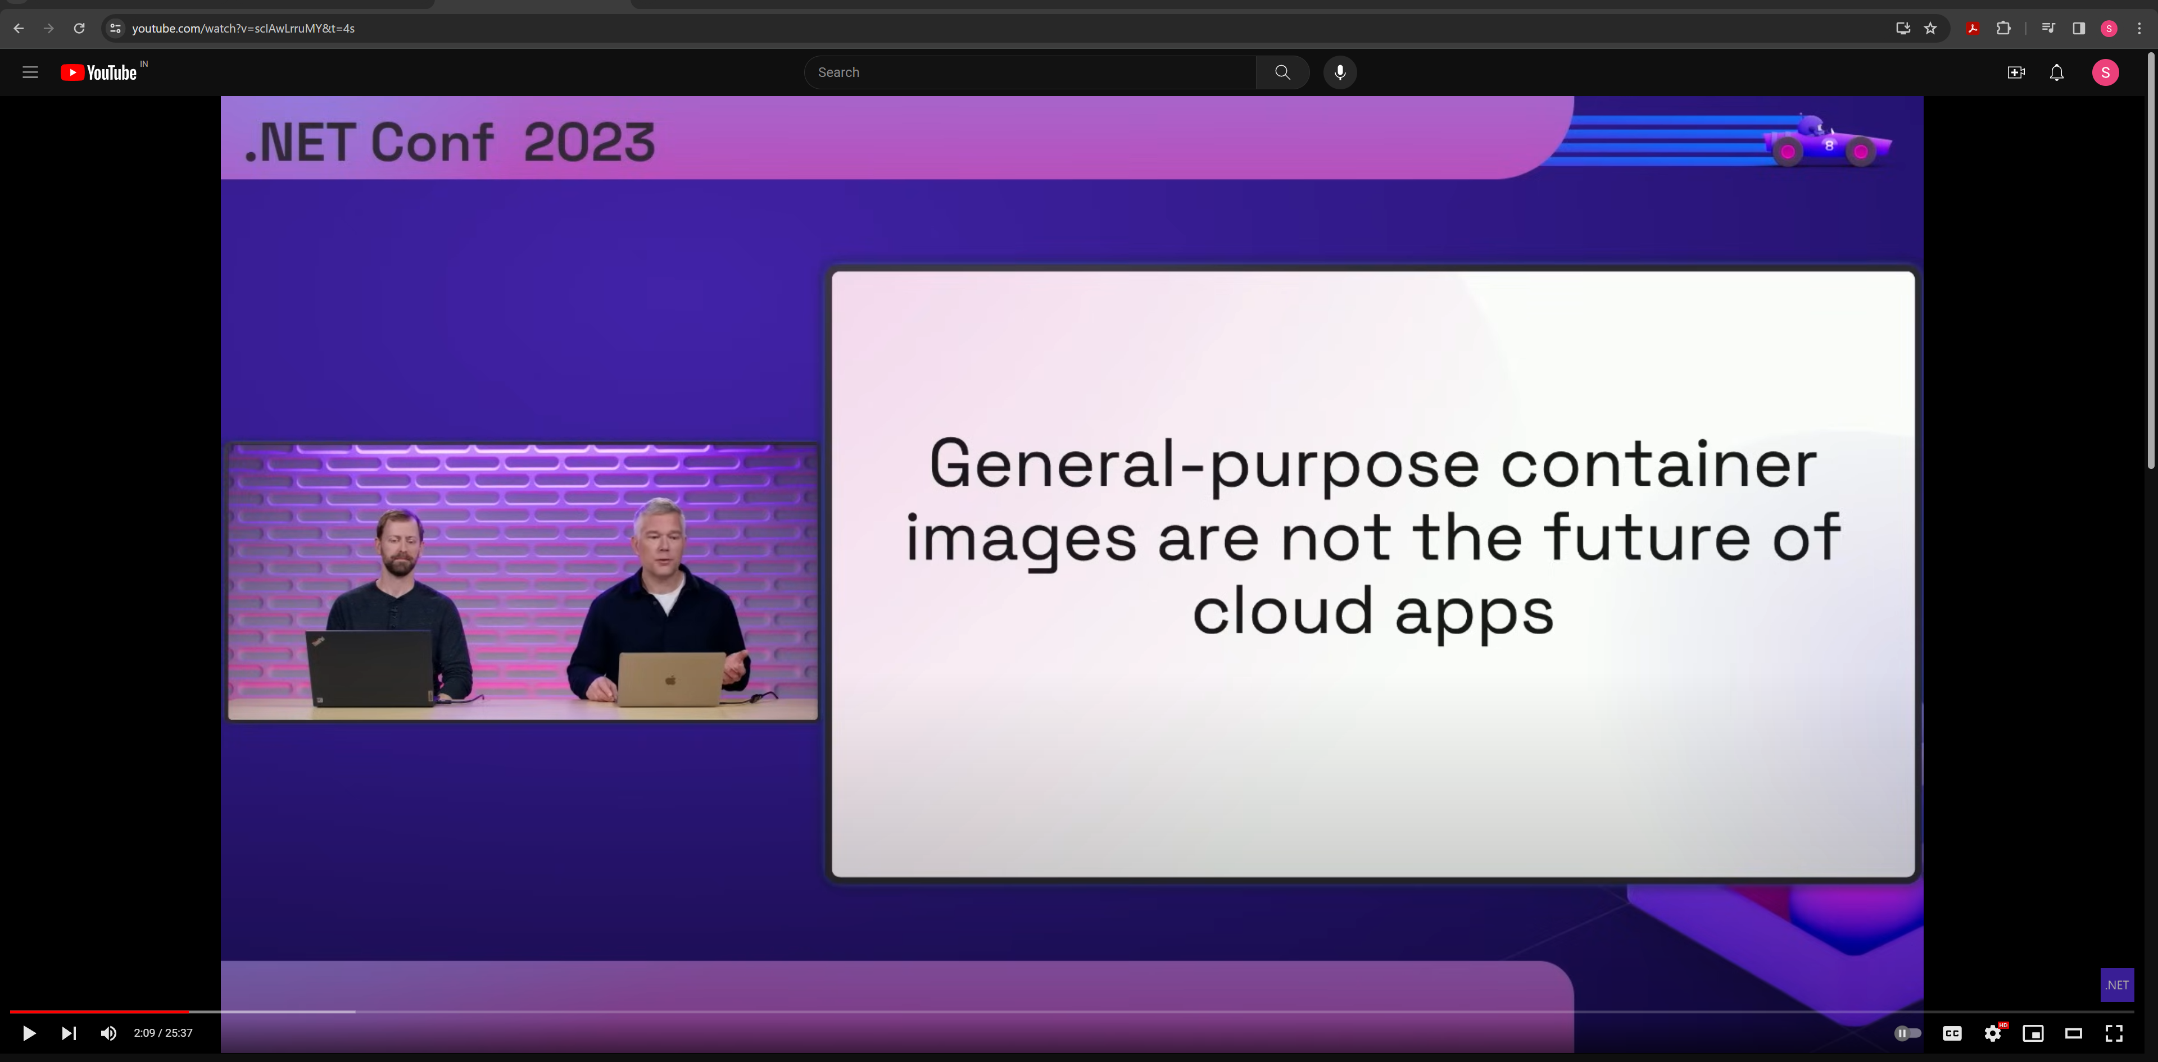

Slide 4
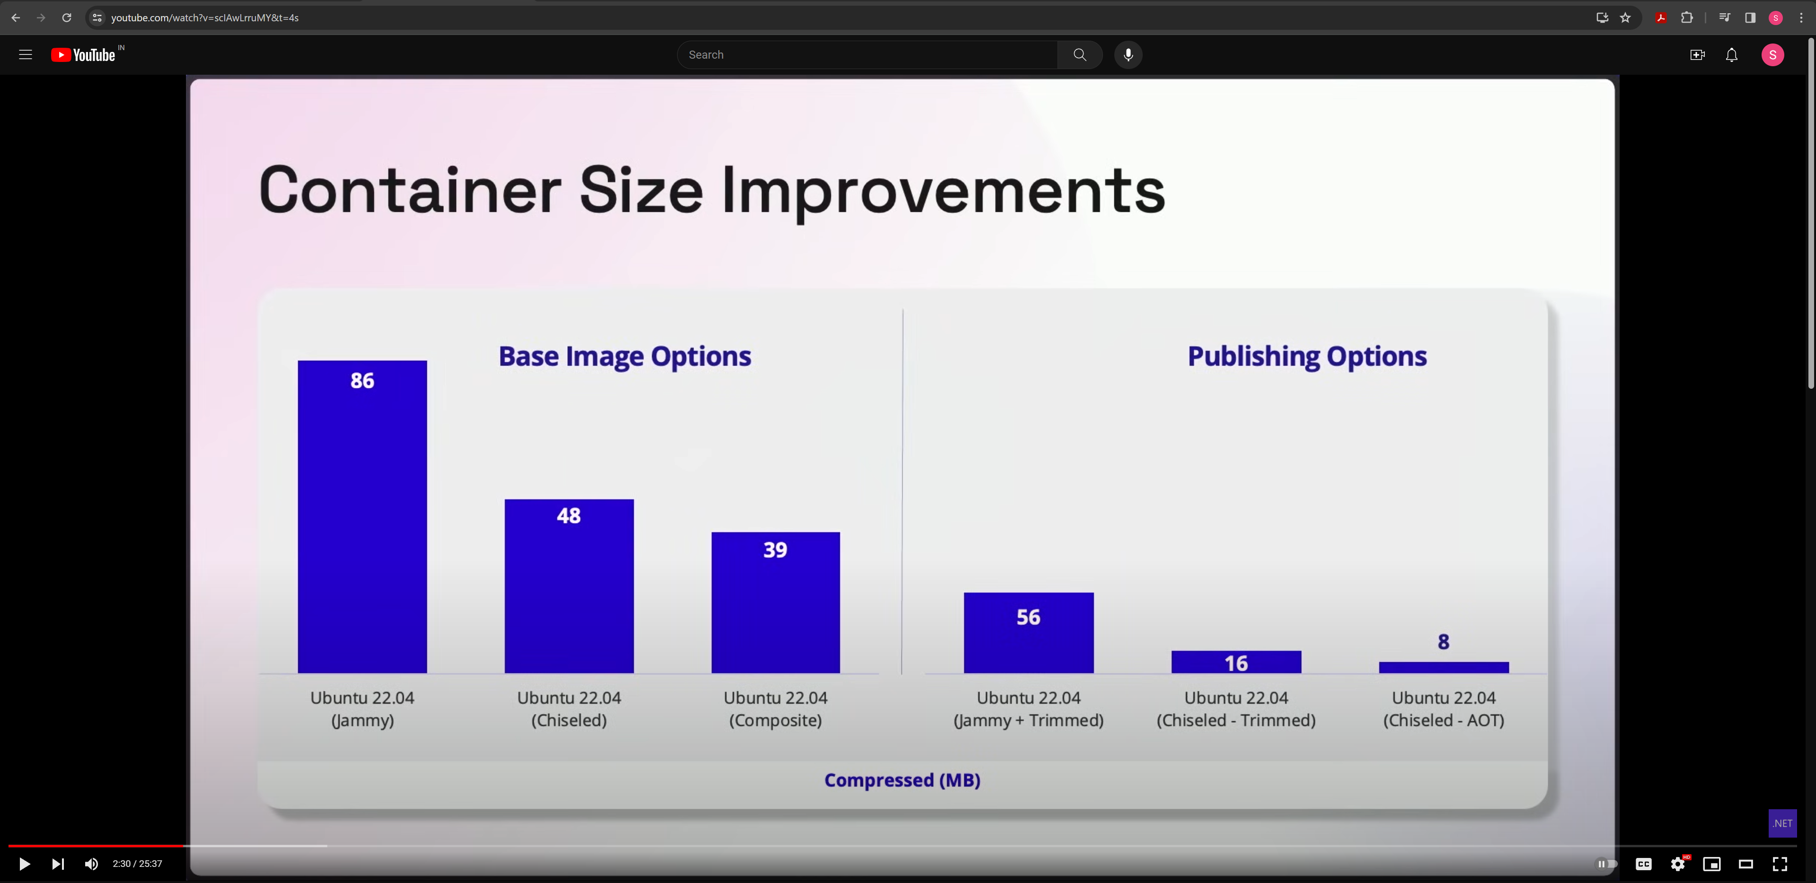

Slide 5
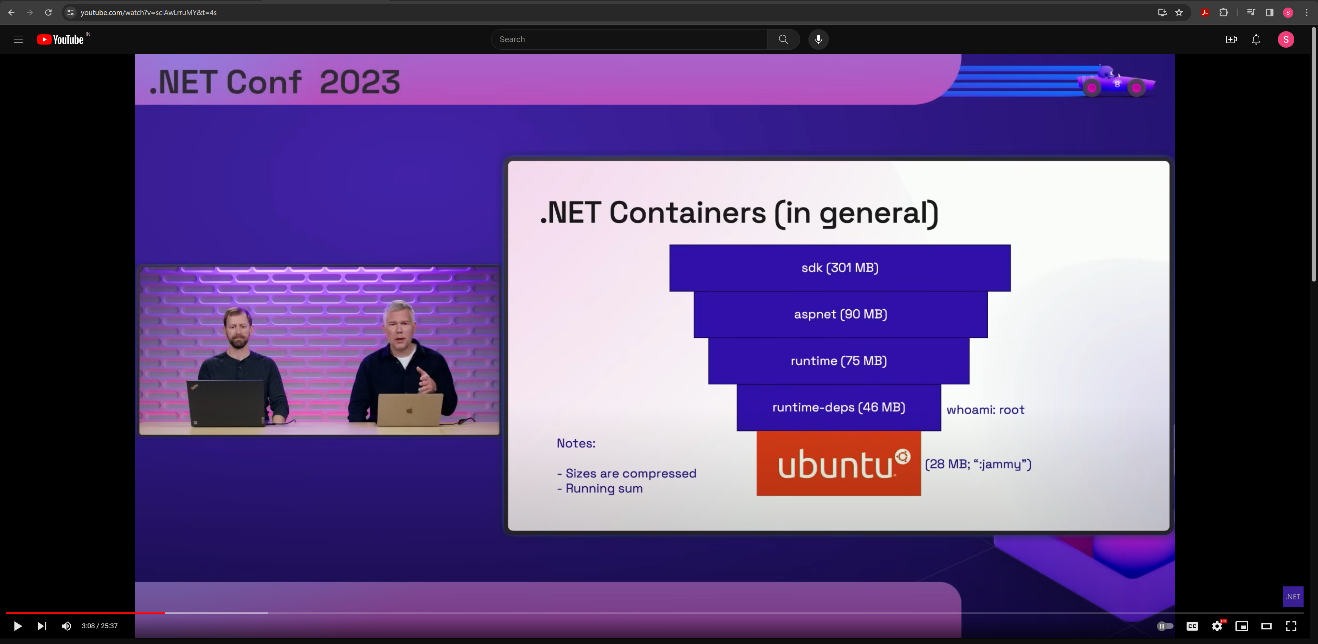

Slide 6
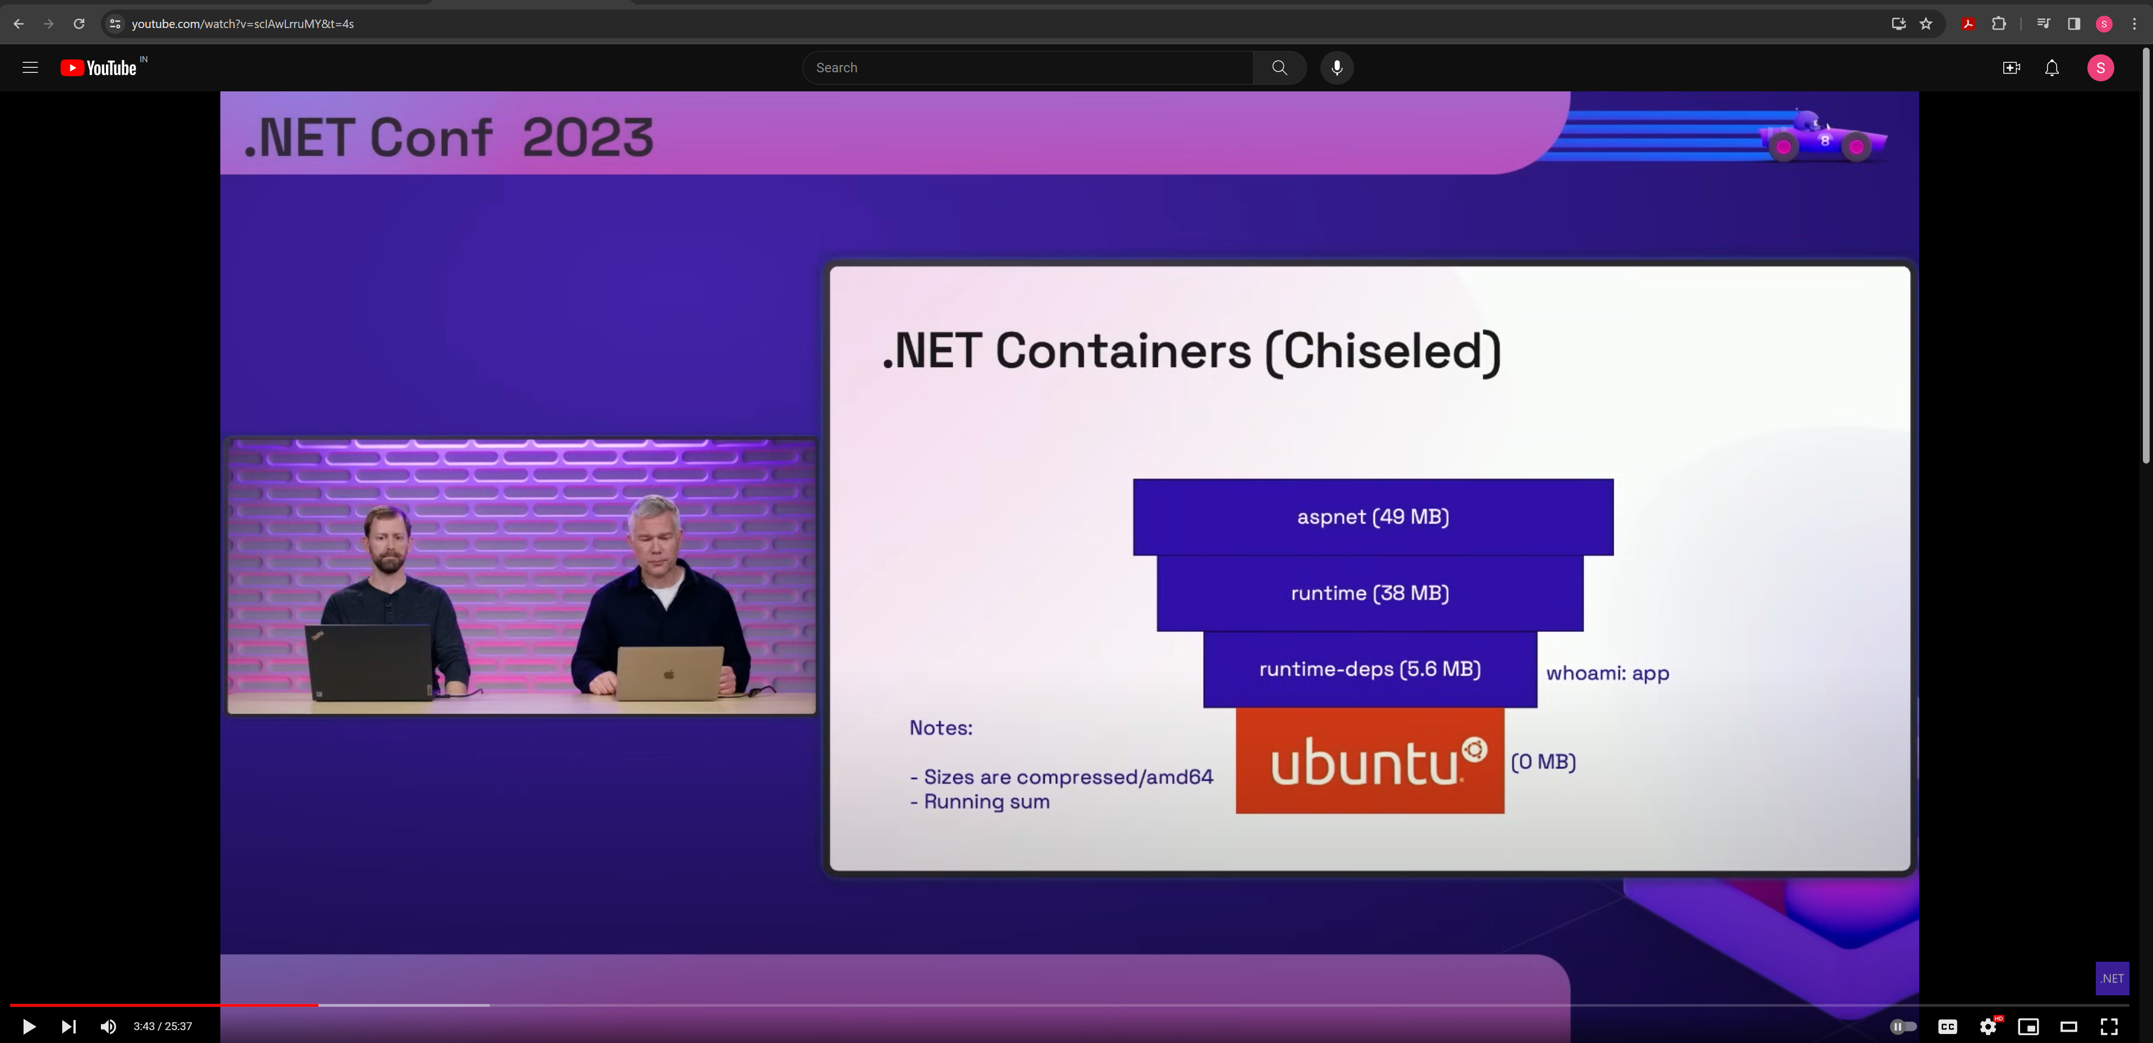

Slide 7
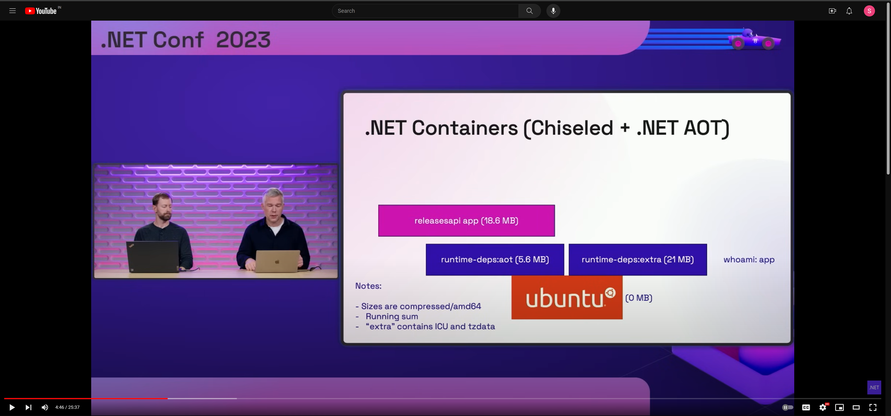

Slide 8
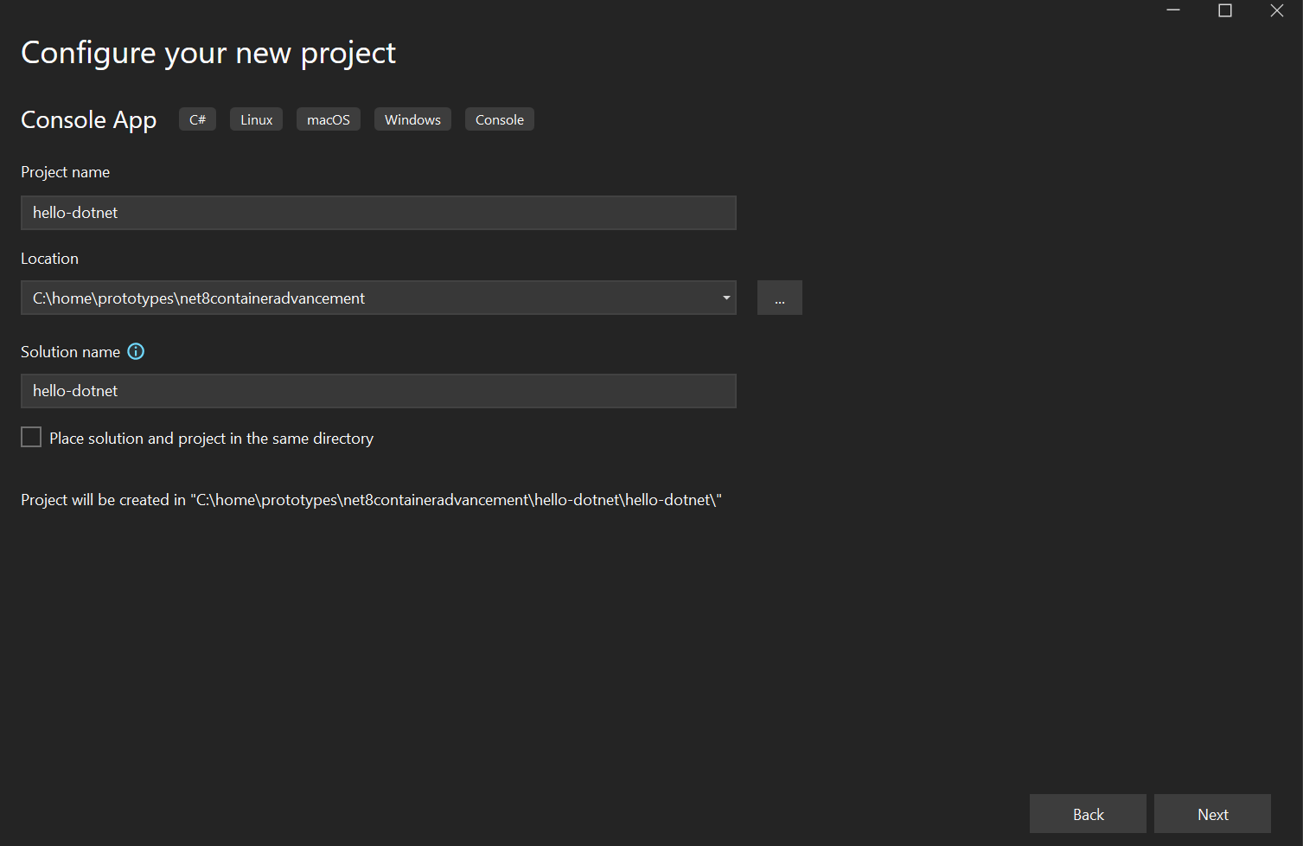
Console App

Slide 9
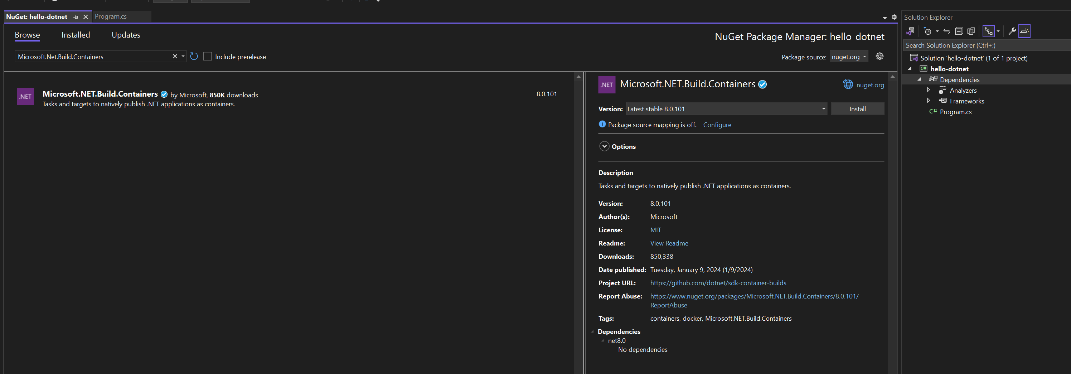
Program

Slide 10
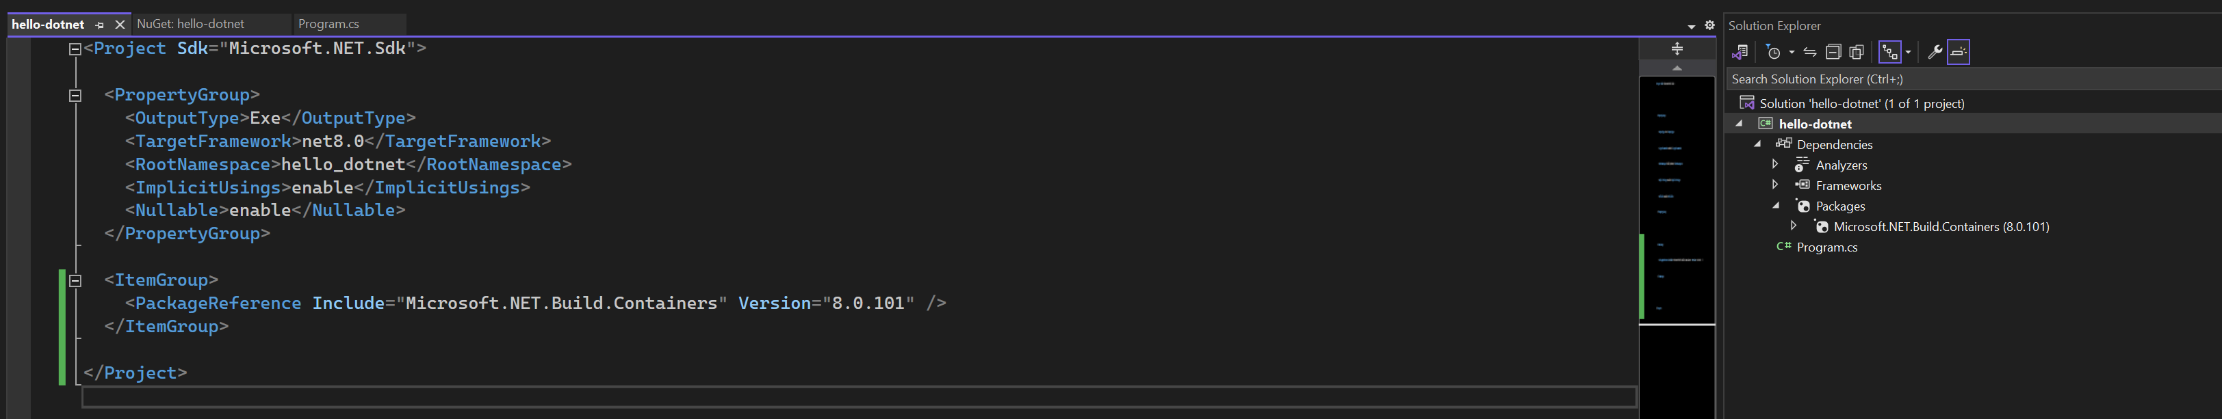
CSPROJ

Slide 11
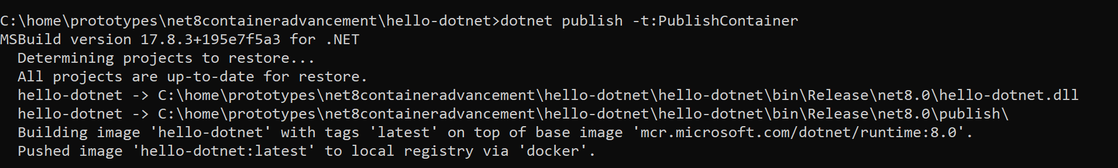
Dotnet build (Default) - 1

Slide 12
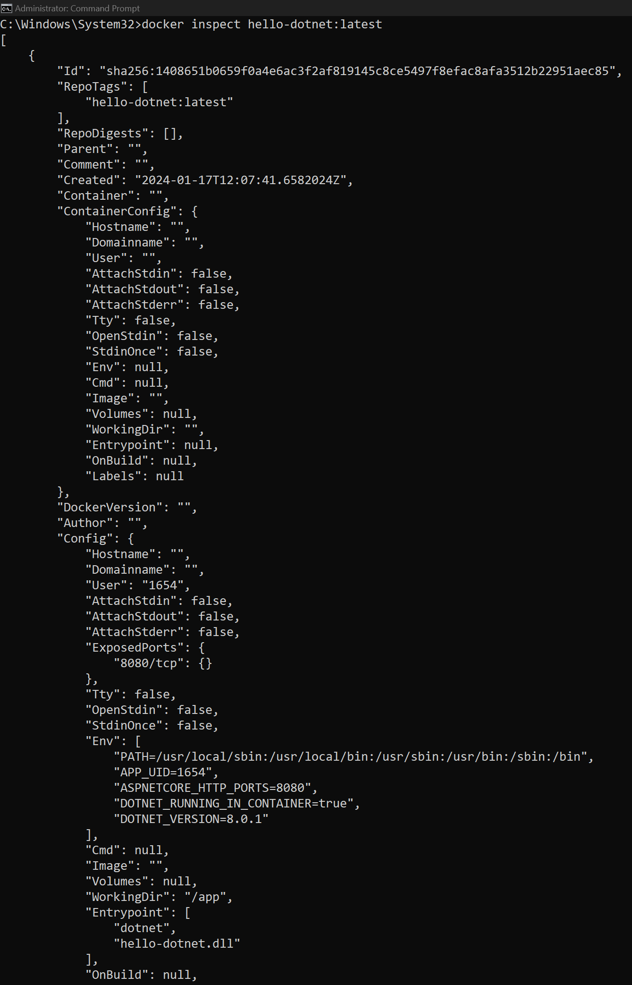
Dotnet build (Default) - 2

Slide 13
Dotnet build (Default) - 3

Slide 14
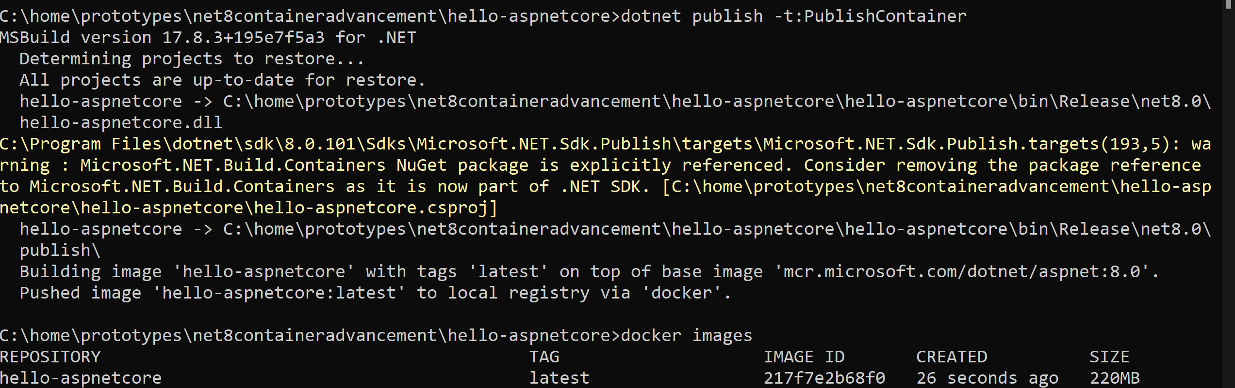
ASP.Net Core

Slide 15
OPTION 2 : DOTNET TRIM

Slide 16
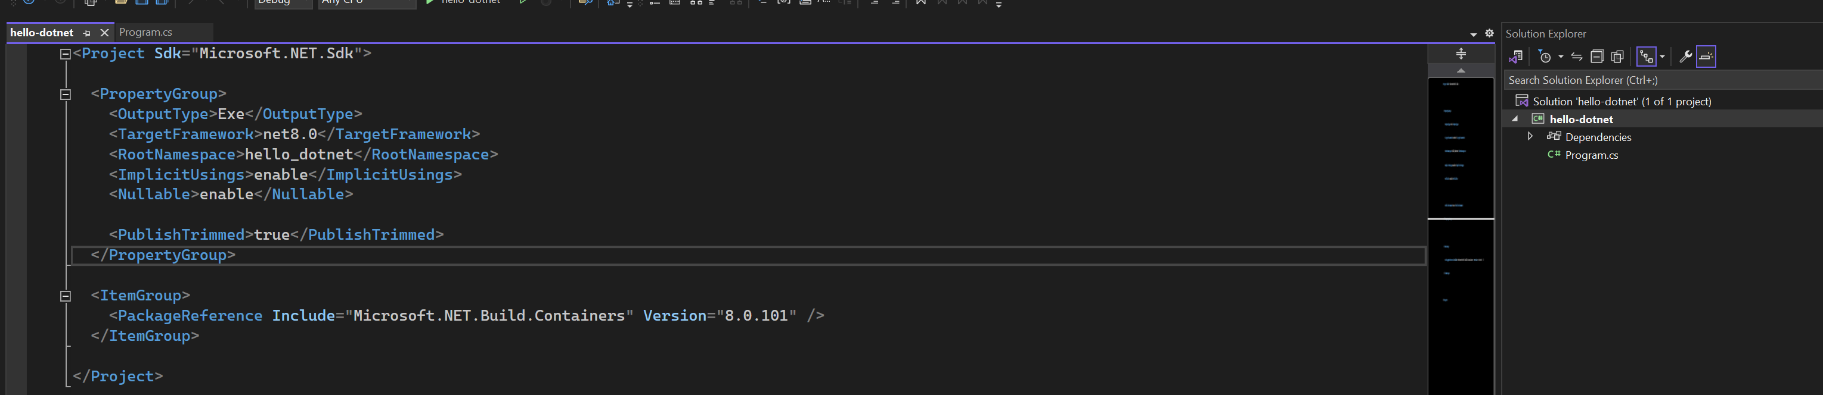
Publish Trim
Inspect the code which you wrote. Use only those references and remove everything else.
Called as self-contained.

Slide 17
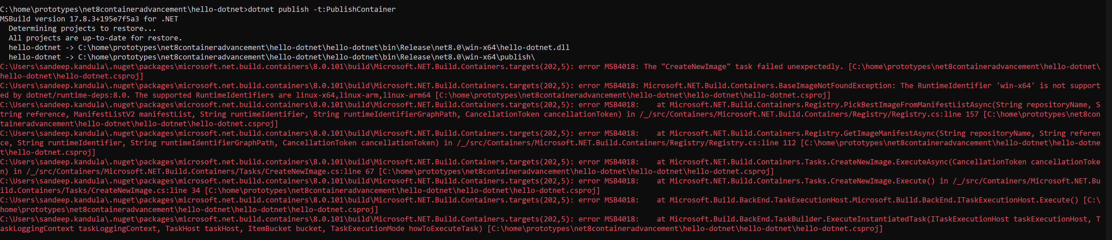
Windows – error , Ubuntu WSL - try

Slide 18
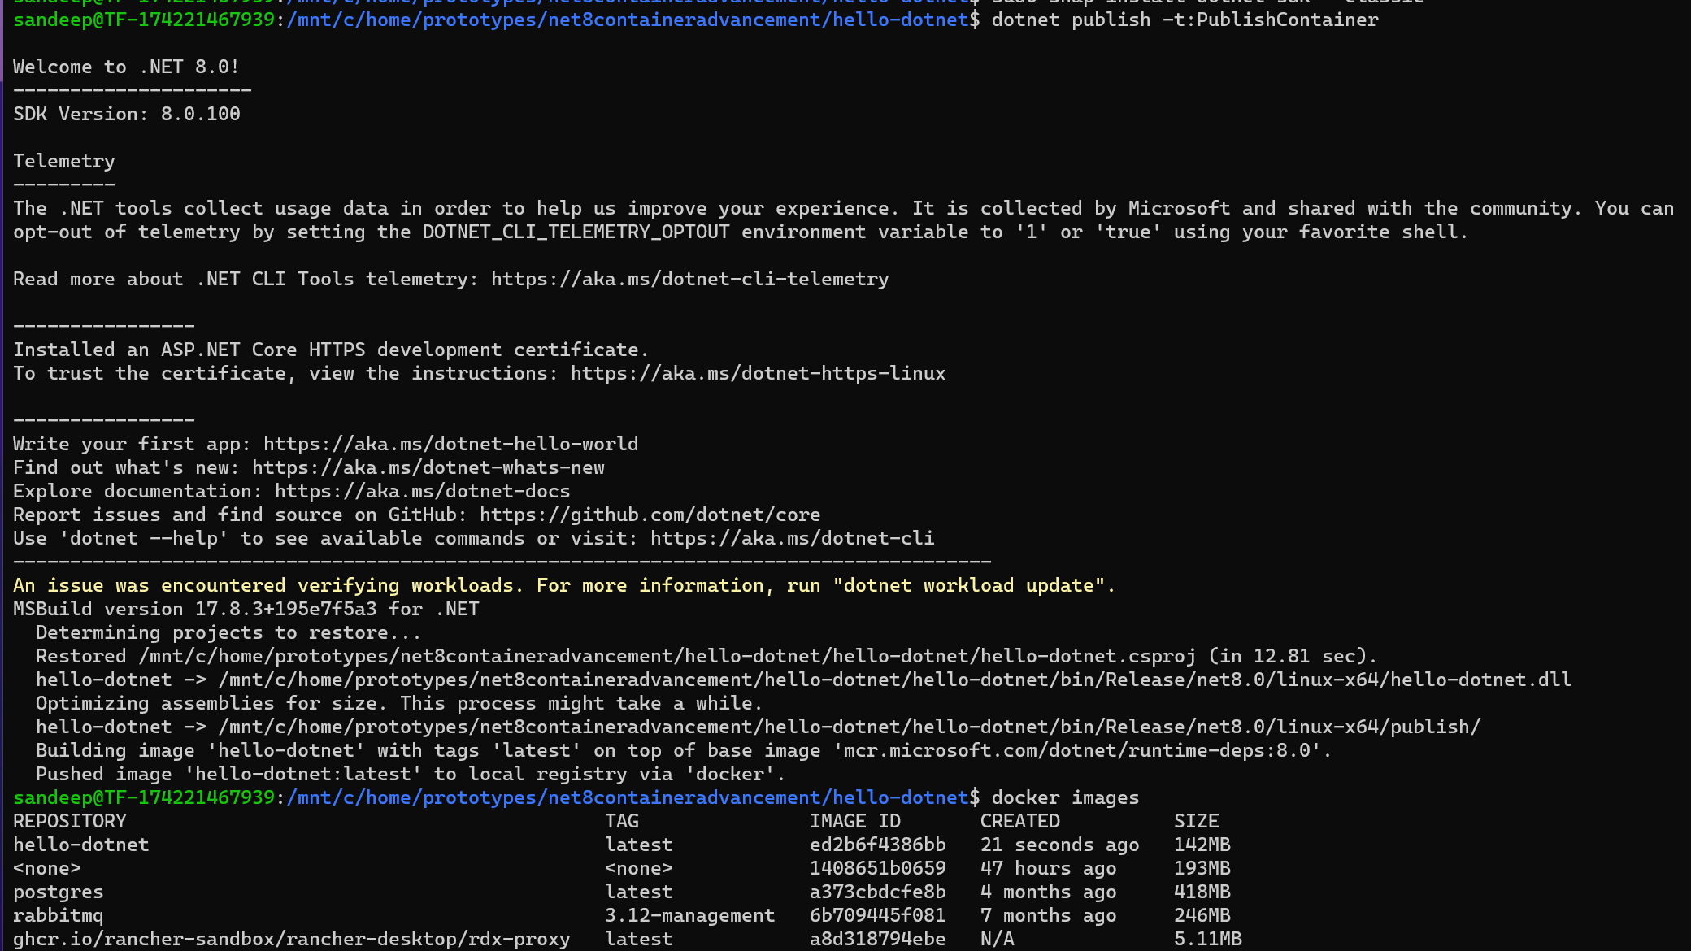

Slide 19
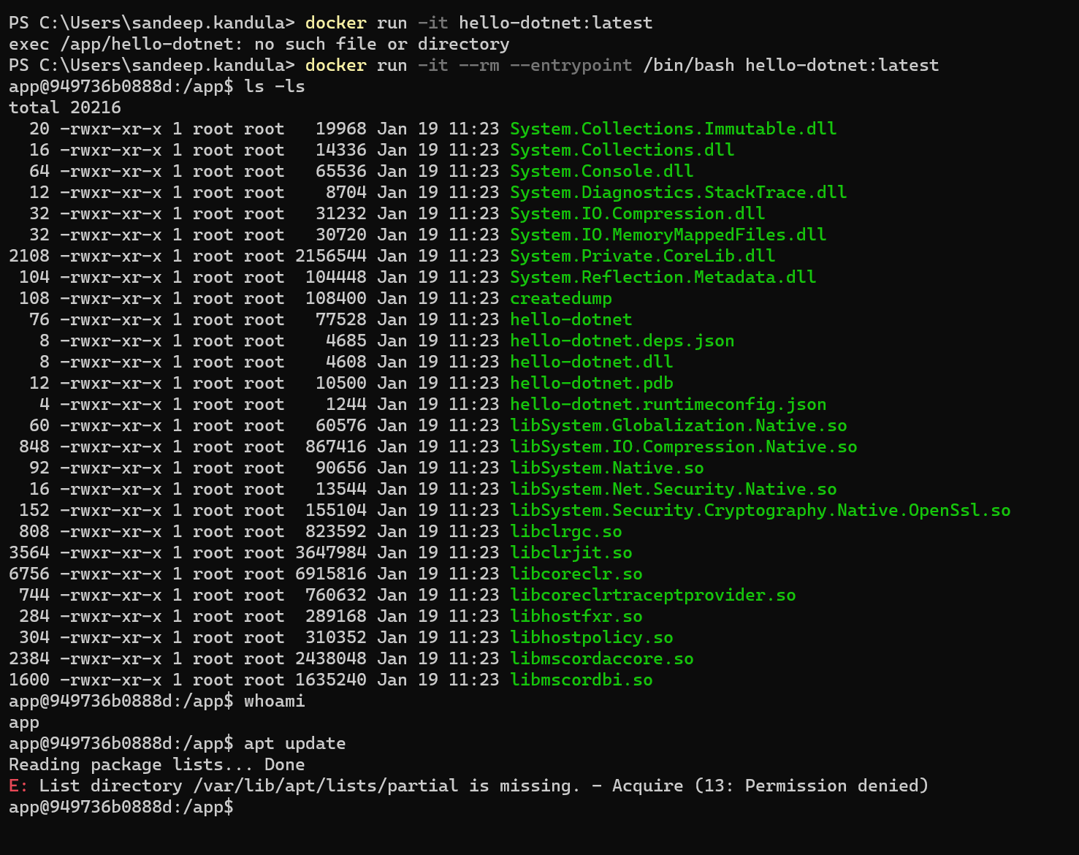
Poke around

Slide 20
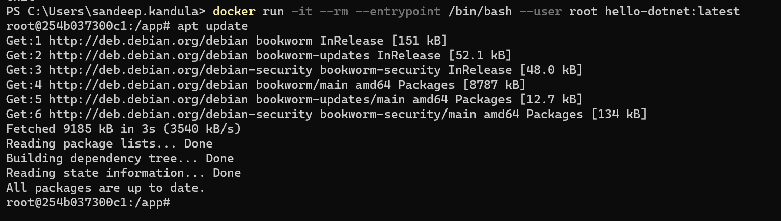
Login using root

Slide 21
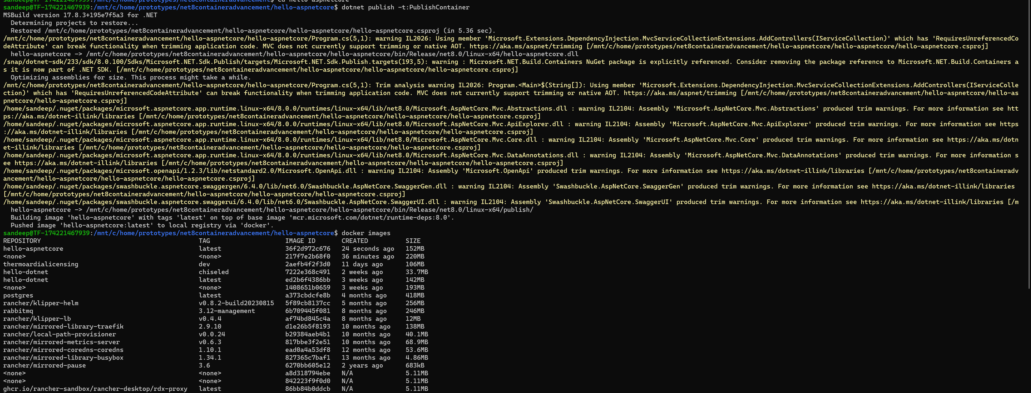
ASPNET CORE

Slide 22
OPTION 3: CHISELED IMAGES

Slide 23
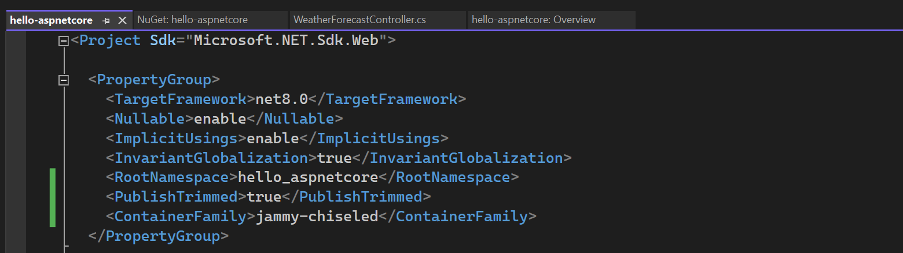
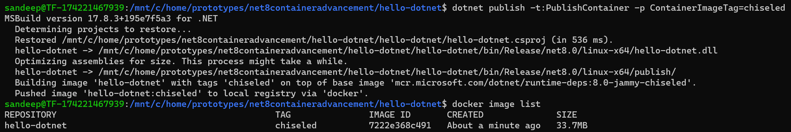
Dotnet chiseled images

Slide 24
Start using bash
Bash is not there to reduce attack surface

Slide 25
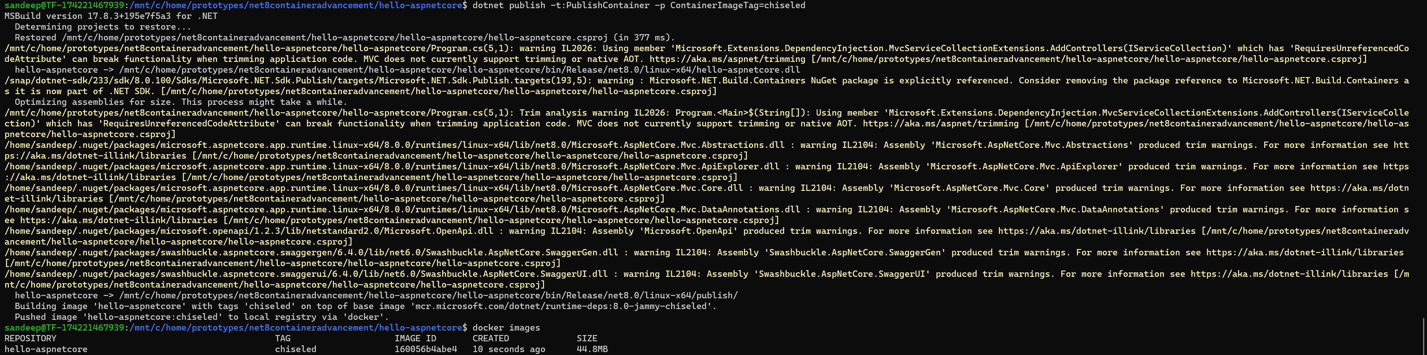
ASPNET CORE

Slide 26
OPTION 4 : AOT

Slide 27
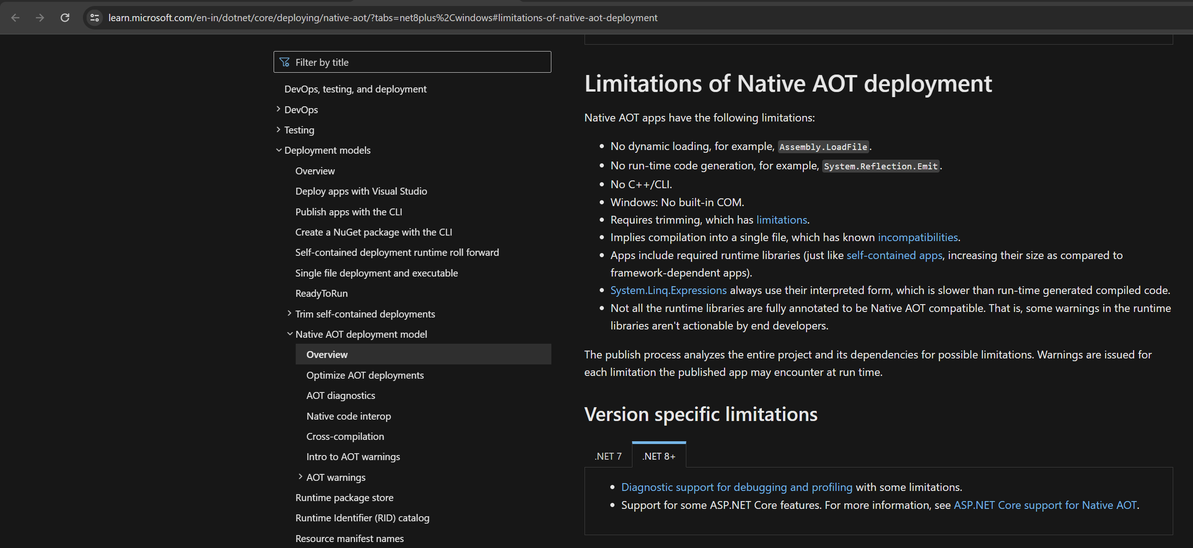
Limitations
https://learn.microsoft.com/en-in/dotnet/core/deploying/native-aot/?tabs=net8plus%2Cwindows#limitations-of-native-aot-deployment

Slide 28
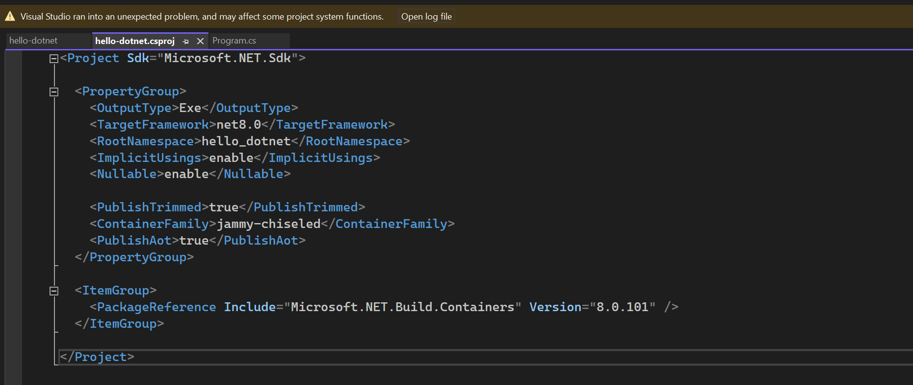
AOT : Compiling directly to native code and we will not have JIT

Slide 29
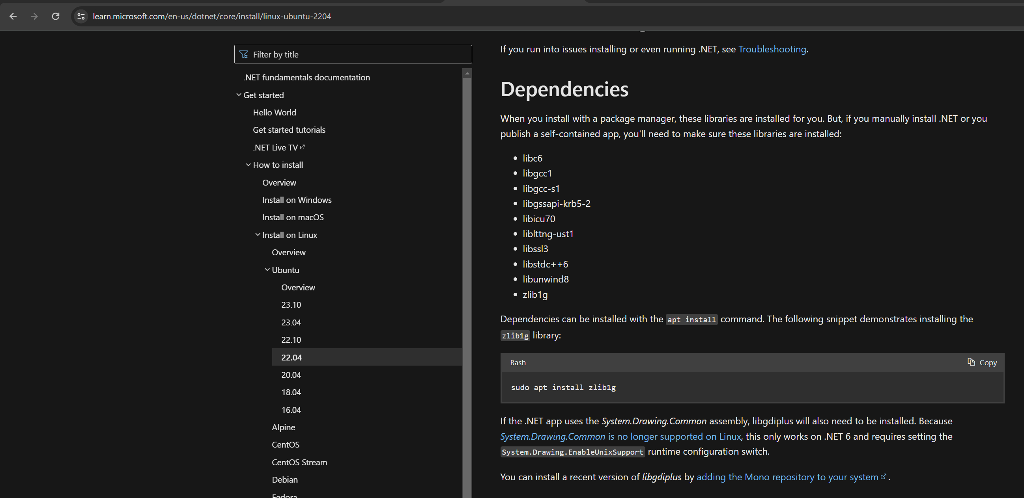
AOT BUILD
https://learn.microsoft.com/en-us/dotnet/core/install/linux-ubuntu-2204

Slide 30
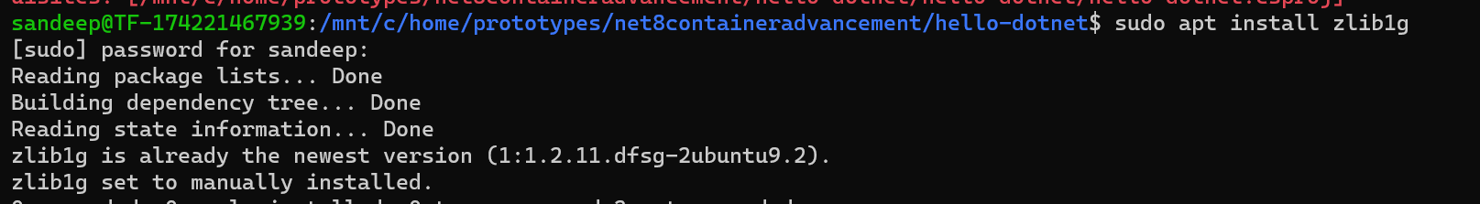
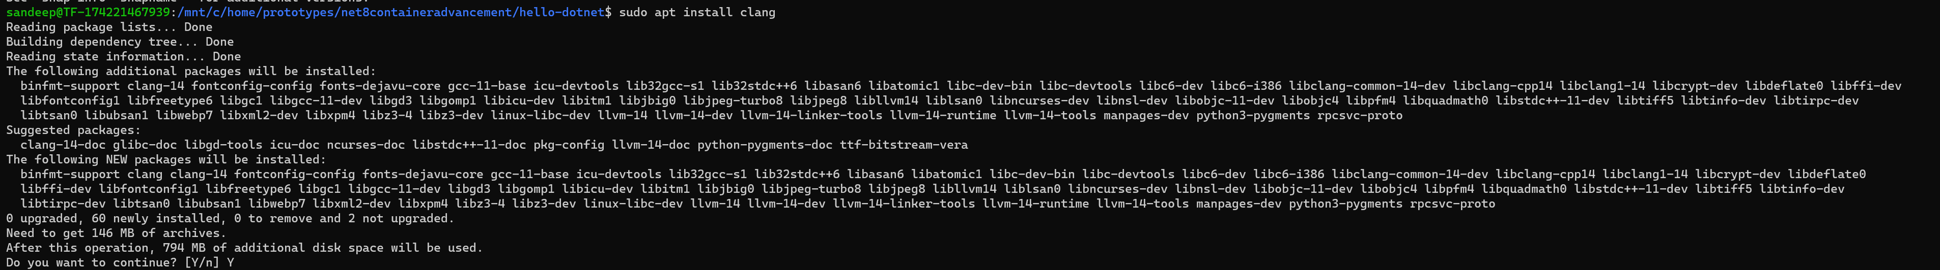
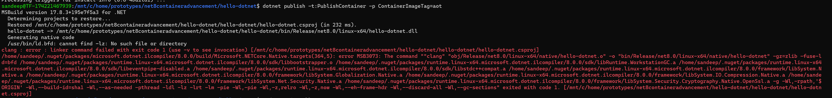
INSTALL DEPENDENCIES

Slide 31
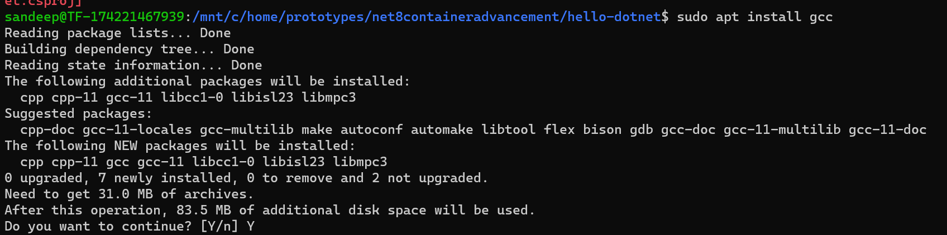
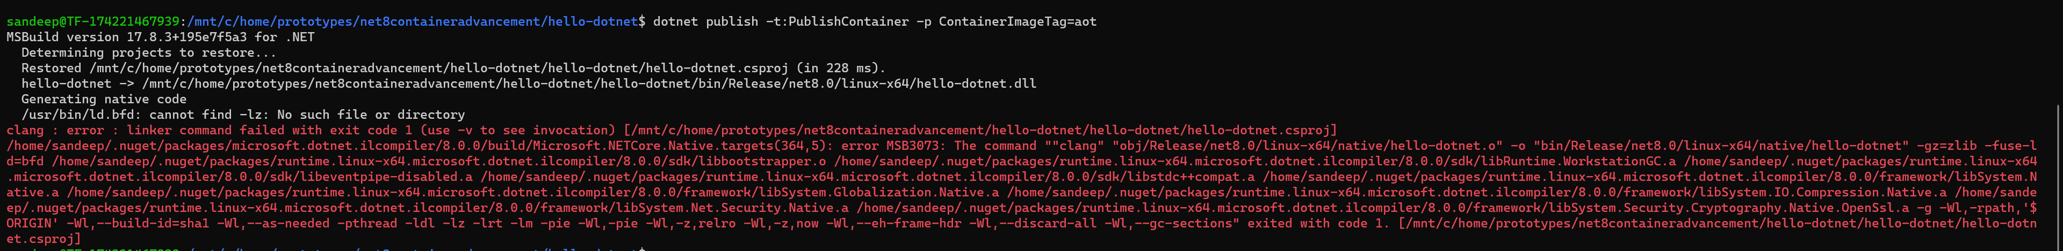
gcc

Slide 32
Defining one to many relationships

Slide 33
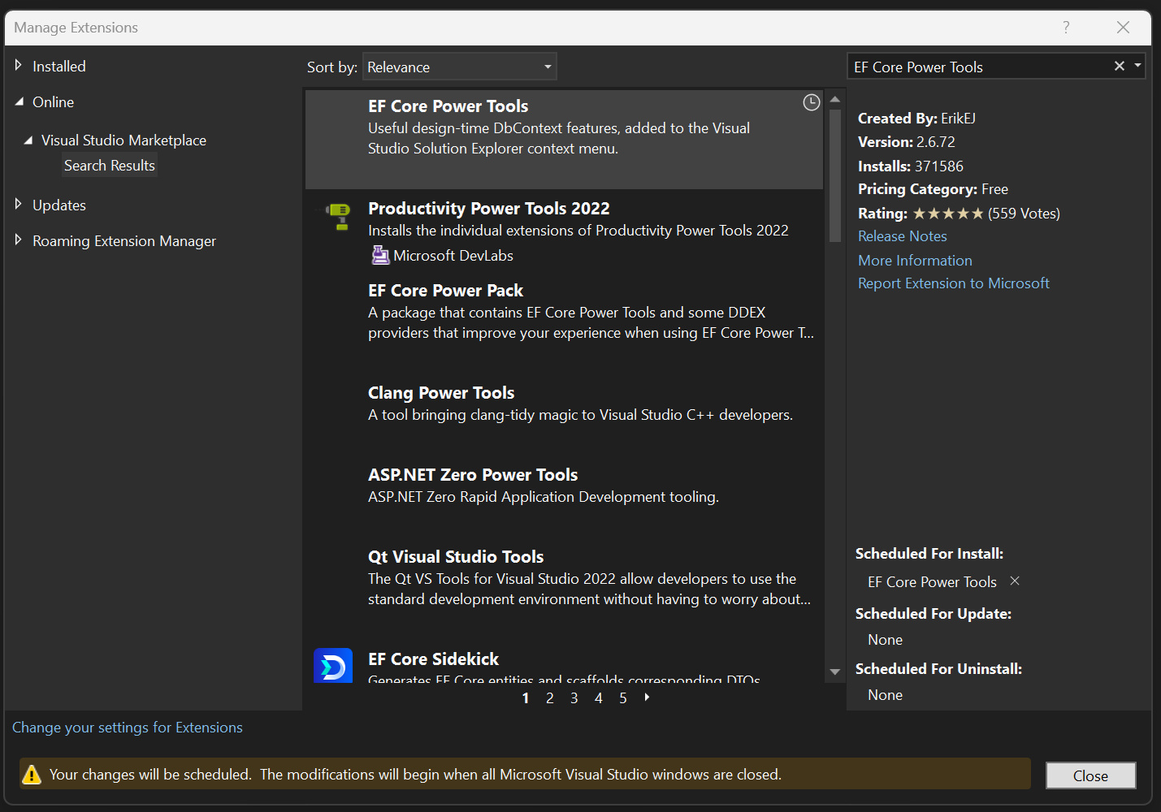
EF Core Power Tools
EF Core Power Tools installer will install VS’ DGML (Directed Graph Modeling Language) Viewer if needed

